Slide 1
Topic 16:
Direct Sensing
16.1 Sensing devices
16.2 The ideal operational amplifier
16.3 Operational amplifier circuits
16.4 Output devices

Slide 2

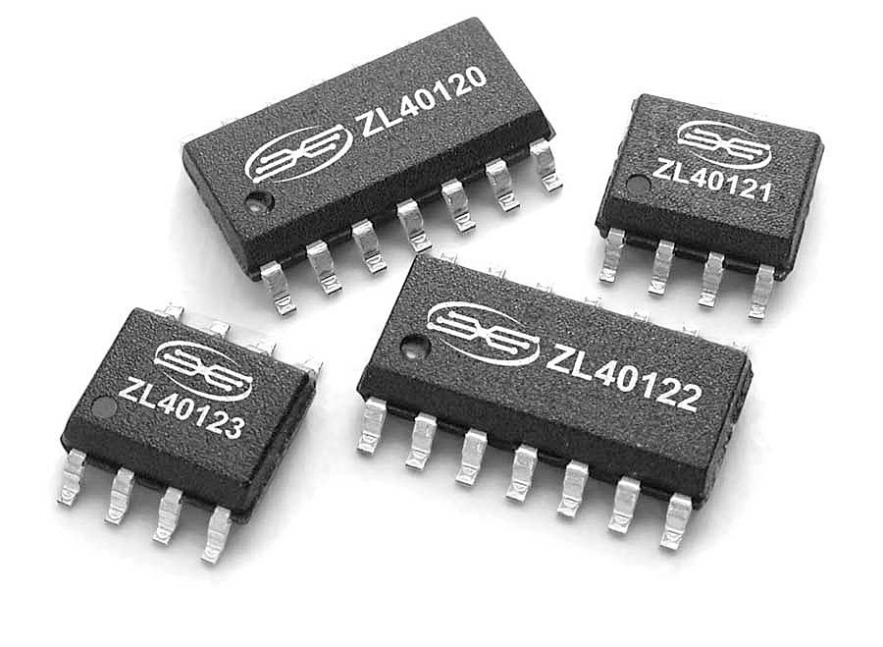
Operational Amplifier
Operational Amplifiers, or Op-amps are one of the basic building blocks of Analogue Electronic Circuits.
It is a device that has all the properties required for nearly ideal DC amplification.
It is an integrated circuit (IC) of about twenty transistors together with resistors and capacitors, all formed on a small slice of silicon.

Slide 3
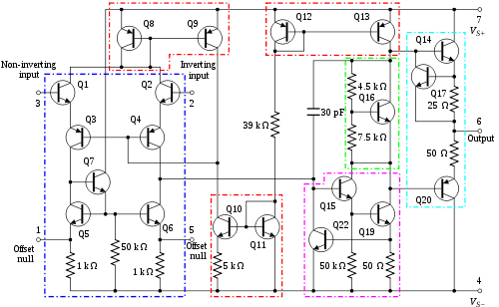
Internal Circuitry
An Operational Amplifier

Slide 4
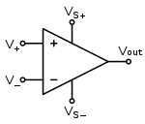
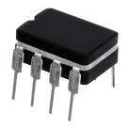

Operational Amplifier
The Symbol
The Actual Device
The Connecting Legs

Slide 5
5 Properties of an Ideal Op-Amp
Infinite Input impedance, (Z_{in})
  Input impedance is assumed to be infinite to prevent any current flowing from the source supply into the amplifiers input circuitry.
Infinite Open loop Voltage Gain, (A)
  The main function of an operational amplifier is to amplify the input signal and the more open loop gain it has the better, so for an ideal amplifier the gain will be infinite.
Zero Output impedance, (Z_{out})
  The output impedance of the ideal operational amplifier is assumed to be zero so that the whole of the output voltage is provided across the output load.
Infinite Bandwidth, (BW)
  An ideal operational amplifier has an infinite Frequency Response and can amplify any frequency signal so it is assumed to have an infinite bandwidth.
Infinite Slew Rate
  Slew rate is a measure of the time delay between the changes to the input and output. With an infinite slew rate there is no delay.

Slide 6
The Real Op-Amp
Input impedance, (Z_{in})
  The input impedance is not infinite but usually between 10⁶ Ω and 10¹² Ω .
Open loop Voltage Gain, (A)
  The open loop gain is not infinite but 10⁵ for constant voltages.
Output impedance, (Z_{out})
  The output impedance is not zero but 10² Ω.
Bandwidth, (BW)
  Bandwidth is not unlimited.
Slew Rate
  Slew rate is not infinite but 10 V μs⁻¹.

Slide 7
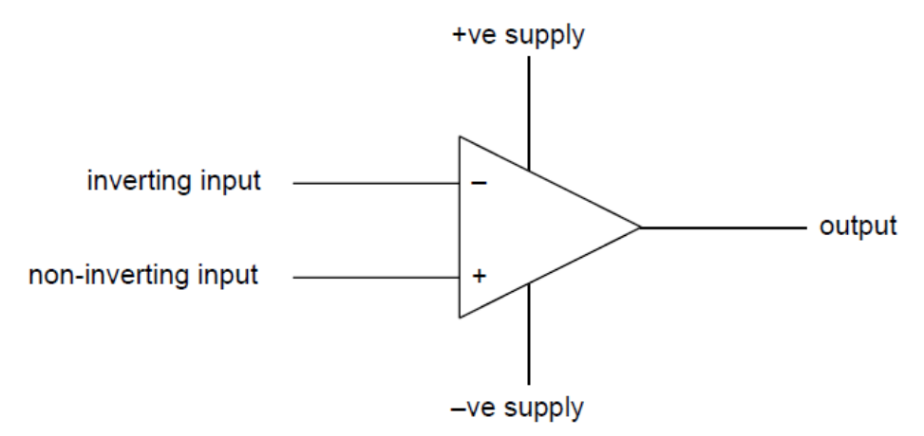
The Output Voltage
When connected to appropriate power supplies, an op-amp produces an output voltage V_{out} that is proportional to the difference between the voltage V⁺ at the non-inverting input and the voltage V⁻ at the inverting input.
V_{out} = A₀ (V ⁺ – V –)
where A₀ is the open-loop gain of the op-amp.

Slide 8
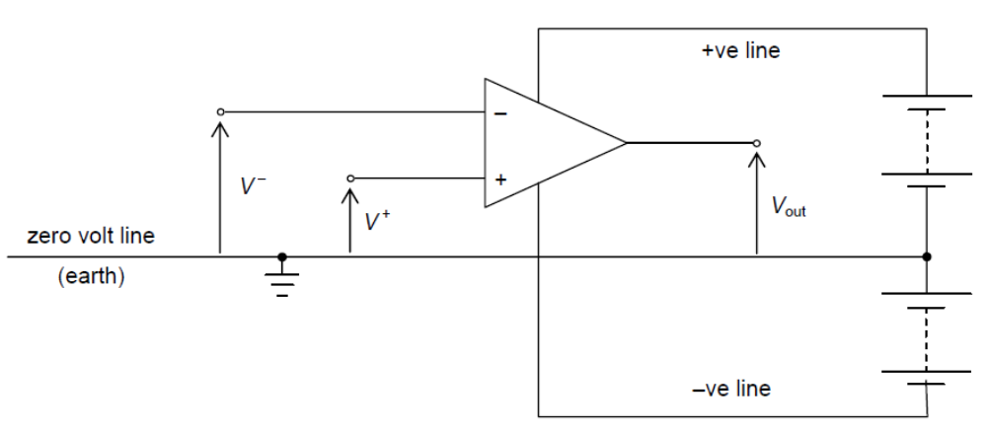
The Power Supply
The common link between the two sets of batteries is termed the zero-volt, or earth, line.
This forms the reference line from which all input and output voltages are measured.
Connecting the supplies in this way enables the output voltage to be either positive or negative.
The diagram shows an input V – connected to the inverting input and an input V ⁺ connected to the non-inverting input. The output voltage V_{out} of the op-amp is given by
V_{out} = A₀ (V ⁺ – V –)
where A₀ is the open-loop gain (typically 10⁵ for d.c. voltages).

Slide 9
Example 1
Given: +ve supply line = +9.0 V
–ve supply line = –9.0 V
V ⁺ = 1.4 V
V – = 1.3 V
What is the output voltage? (A₀ = 10⁵)
Solution:
V_{out} = A₀ (V ⁺ – V –) = 10⁵ (1.4 – 1.3) = 10 000 V
V_{out} = 9.0 V
This is not possible, the output voltage cannot exceed the power supply voltage.
The amplifier is said to be saturated.
V_{output} = the power supply voltage

Slide 10
Example 2
Conclusion:
If V⁺ < V⁻, the output is negative
Given: +ve supply line = +6.0 V
–ve supply line = –6.0 V
V ⁺ = 3.652 V
V – = 3.654 V
What is the output voltage? (A₀ = 10⁵)
Solution:
V_{out} = A₀ (V ⁺ – V –) = 10⁵ (3.652 – 3.654) = -200 V
V_{out} = -6.0 V
The amplifier is saturated.
V_{output} = the power supply voltage
In this case the output voltage is negative.

Slide 11
Example 3
Given: +ve supply line = +15.0 V
–ve supply line = –15.0 V
V ⁺ = 0.9000 V
V – = 0.8999 V
What is the output voltage? (A₀ = 10⁵)
Solution:
V_{out} = A₀ (V ⁺ – V –) = 10⁵ (0.9000 – 0.8999) = 10 V
V_{out} = 10.0 V
Conclusion:
For the amplifier to be not saturated, the two inputs must be almost identical (same potential).
The amplifier is not saturated.

Slide 12
Example 4
The open-loop gain of an operational amplifier is 10⁵. If the supply is ±9.0 V, what is the minimum difference in input voltages that will cause the output to be saturated?
Solution:
V_{out} = A₀ (V ⁺ – V –)
(V ⁺ – V –) = V_{out} / A₀
= 9.0 / 10⁵
= 9.0 × 10-⁵ V

Slide 13
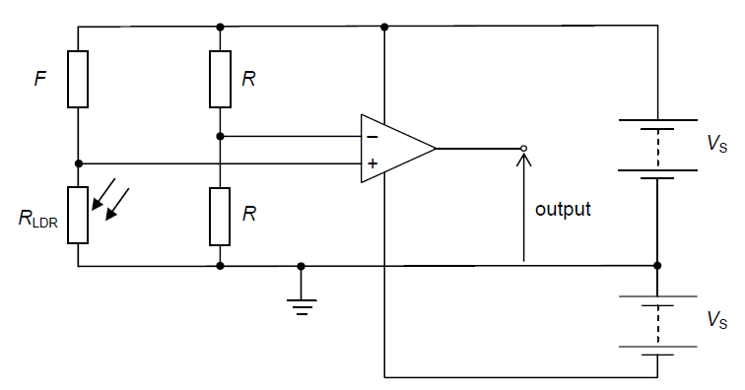
Op-Amp as a Comparator
The LDR could be replaced by other sensors to provide alternative sensing devices. For example, use of a thermistor could provide a frost-warning device.
The comparator is an open loop connection, there is no feedback from the output. So
V_{out} = A₀ (V ⁺ – V –) applies
It is usual to connect a potential divider to each of the two inputs. One potential divider provides a fixed voltage at one input while the other potential divider provides a voltage dependent on a sensor.
In the diagram, the resistors of resistance R will give rise to a constant voltage of ½V_{S} at the inverting input. The LDR, of resistance R_{LDR} is connected in series with a fixed resistor of resistance F.
If R_{LDR} > F (that is, the LDR is in darkness), then V ⁺ > V – and the output is positive.
If R_{LDR} < F (that is, the LDR is in daylight), then V ⁺ < V – and the output is negative.
It can be seen that by suitable choice of the resistance F, the comparator gives an output, either positive or negative, that is dependent on light intensity. The light intensity at which the circuit switches polarity can be varied if the resistor of resistance F is replaced with a variable resistor.

Slide 14
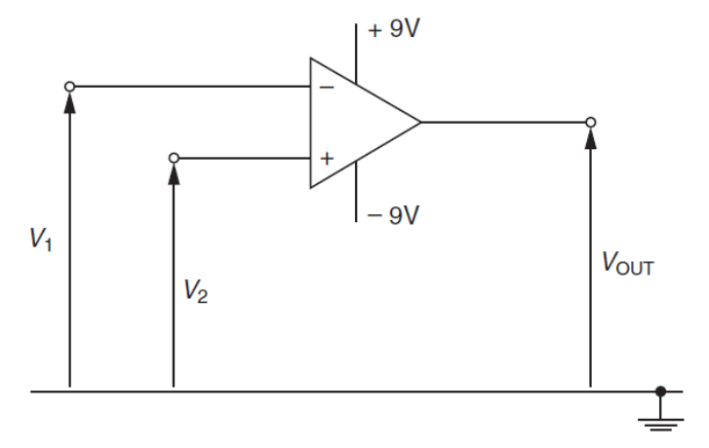
Example 5
The diagram shows a circuit incorporating an ideal operational amplifier (op-amp). The voltages applied to the inverting and the non-inverting inputs are V₁ and V₂ respectively.
State the value of the output voltage V_{OUT} when
(a) V₁ > V₂ (b) V₁ < V₂
Solution:
For an ideal operational amplifier, the gain is infinite and hence it is saturated.
(a) When V₁ > V₂ ➔ V⁻ > V⁺, therefore V_{out} is negative, V_{out} = -9 V
(b) When V₁ < V₂ ➔ V⁺ > V⁻, therefore V_{out} is positive, V_{out} = +9 V

Slide 15
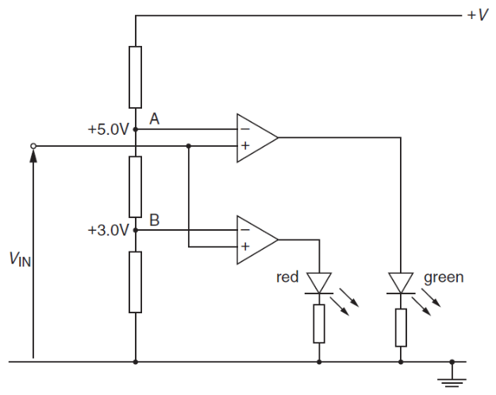
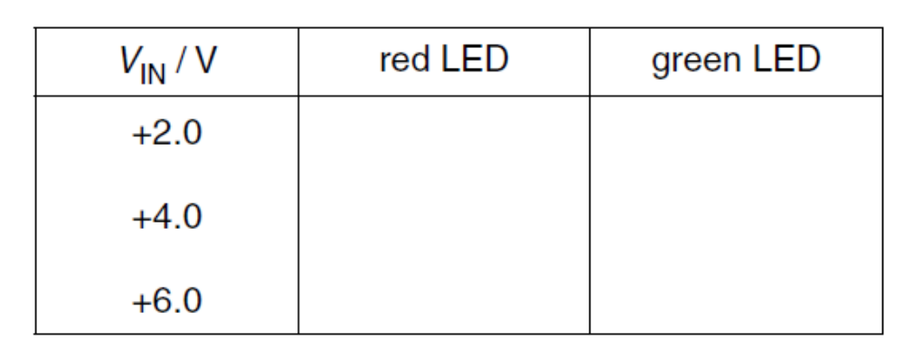
Example 6
The circuit shown is used to monitor the input voltage V_{IN}. At point A, a potential of 5.0 V is maintained. At point B, a potential of 3.0 V is maintained.
Complete the table given by indicating with a tick (✓) the light-emitting diodes (LEDs) that are conducting for the input voltages V_{IN} shown. Also, mark with a cross (×) those LEDs that are not conducting.
Solution:
× (V⁺ < V⁻)
× (V⁺ < V⁻)
√ (V⁺ > V⁻)
× (V⁺ < V⁻)
√ (V⁺ > V⁻)
√ (V⁺ > V⁻)

Slide 16
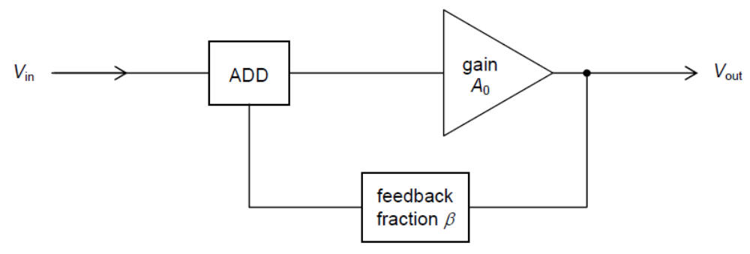
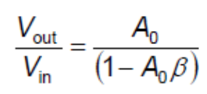
Feedback
The process of taking some, or all, of the output of the amplifier and adding it to the input is known as feedback.
A fraction β of the output voltage of the amplifier is fed back and added to the input voltage.
The amplifier itself amplifies by an amount A₀ whatever voltage is present at its input.
The output voltage V_{out} is given by
V_{out} = A₀ × (input to amplifier)
= A₀ × (V_{in} + βV_{out})
Re-arranging, V_{out} (1 – A₀β) = A₀ × V_{in}.
The overall voltage gain of the amplifier with feedback is then given by

Slide 17
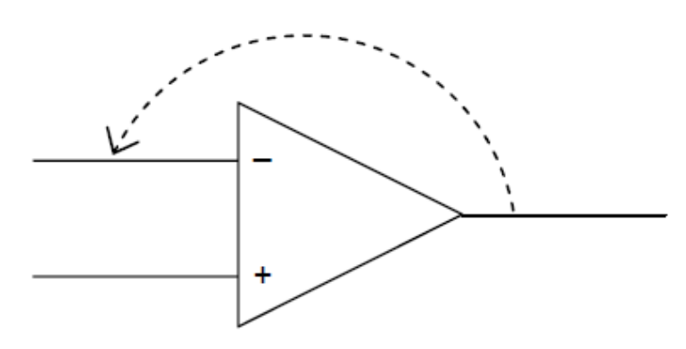
Negative Feedback
If the fraction β is negative ➔ denominator is greater than unity ➔ overall gain smaller than the open-loop gain A₀
This can be achieved by feeding back part of the output to the inverting input.
The reduction in amplification may bring the following benefits:
an increase in the range of frequencies over which the gain is constant (increased bandwidth),
less distortion,
greater operating stability.

Slide 18
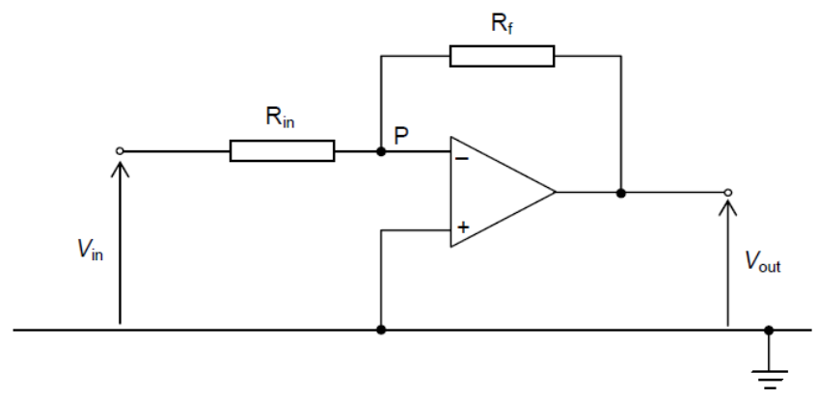
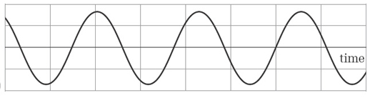
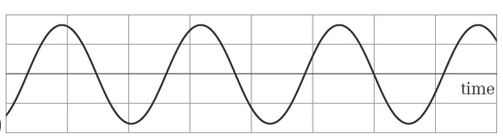
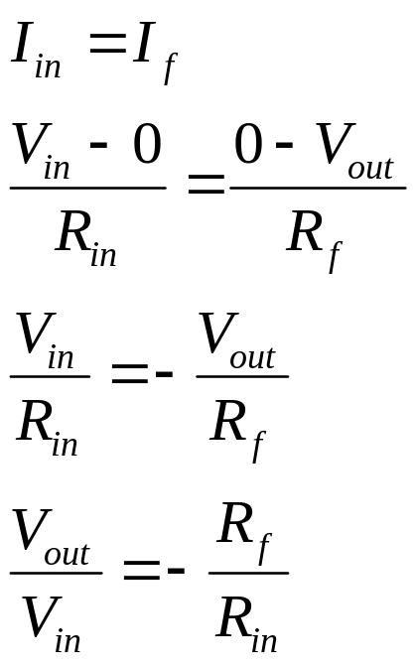
The Inverting Amplifier
For inverting amplifier, V_{in} is fed into V ⁻.
The inverting amplifier is a negative feedback connection.
I
I
At V ⁺, V = 0 (earth)
To ensure amplifier is not saturated, V ⁻ ≈ V ⁺
Therefore, at point P, V ≈ V ⁺ ≈ 0 ➔ VIRTUAL EARTH
If V_{in} is positive, current flows from input to output.
I at V ⁻ is 0 since input impedance is ∞.
Therefore:
The inverting amplifier inverts the polarity of the output.
V_{out} is π rad out of phase with the input voltage.
A₀

Slide 19
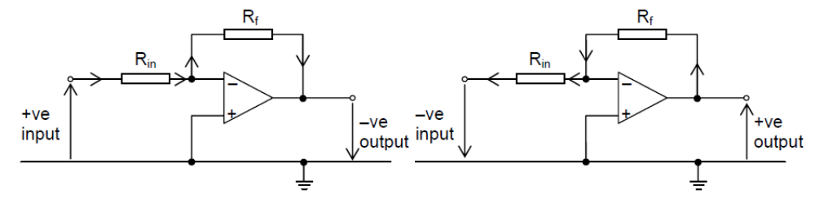
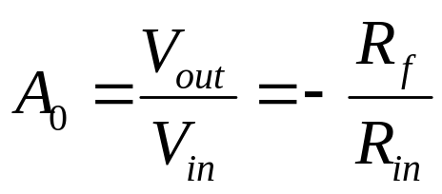
The Inverting Amplifier
If the input is negative, current flows in the opposite direction but it is still the same current flowing through both R_{in} and R_{f}.

Slide 20
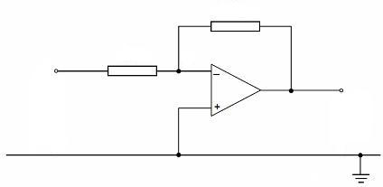
Example 7
22 kΩ
10 kΩ
V_{in}
V_{o}
The circuit shows an inverting amplifier. The input voltage is 0.44 V. Calculate the output voltage.
Solution:
V_{out} = −(R_{f} / R_{in}) × V = −(22 / 10) × 0.44 = − 0.968 V

Slide 21
Example 8
10 kΩ
2.0 kΩ
V_{in}= 0.20 V
V_{out}
The diagram shows an inverting amplifier.
Find its gain A₀ and the output voltage V_{out}.
Solution:
A₀ = −(R_{f} / R_{in}) = −(10 / 2.0) = −5
V_{out} = A₀ × V_{in} = −5.0 × 0.20 = −1.0 V
When R_{f} > R_{in}
A₀ > 1 (increase)
When A₀ > 1
V_{out} > V_{in} (increase)

Slide 22
Example 9
10 kΩ
5.0 kΩ
V_{in}
V_{out}
The diagram shows an amplifier circuit.
(a) What is its voltage gain A₀?
(b) What is the output voltage when the input voltage is
(i) +0.5 V (ii) -1.3 V .
Solution:
(a) A₀ = −(R_{f} / R_{in}) = −(10 / 5.0) = −2
(b) (i) V_{out} = A₀ × V_{in} = −2 × 0.5 = −1.0 V
(ii) V_{out} = A₀ × V_{in} = −2 × (− 1.3) = +2.6 V
When V_{in} is positive
V_{out} is negative
When V_{in} is negative
V_{out} is positive

Slide 23
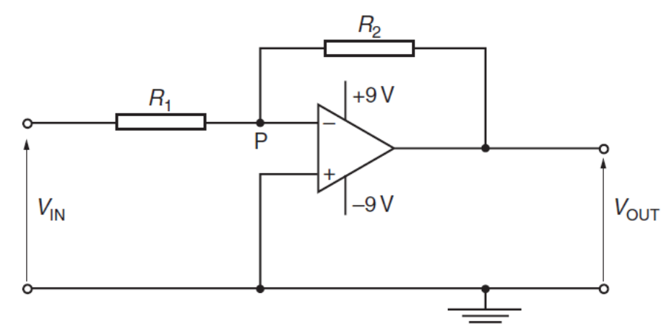
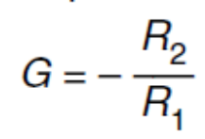
Example 10
Solution (b):
input resistance is very large
(so) current in R₁ = current in R₂
I = V_{IN} / R₁
I = – V_{OUT} / R₂
hence gain = V_{OUT} / V_{IN} = –R₂ / R₁
The circuit for an amplifier incorporating an ideal operational amplifier (op-amp) is shown in the diagram.
(a) State (i) the name of this type of amplifier circuit,
(ii) why the point P is referred to as a virtual earth.
(b) Show that the gain G of this amplifier circuit is given by the expression:
Explain your working.
Solution:
(a) (i) inverting amplifier
(ii) Gain of op-amp is very large, in order that the amplifier does not saturate, voltage of the inverting input V⁻ must be approximately equal to the voltage of the non-inverting input V⁺. Since V⁺ is earth, V_{p} = V⁻ must also be earth (virtual earth).

Slide 24
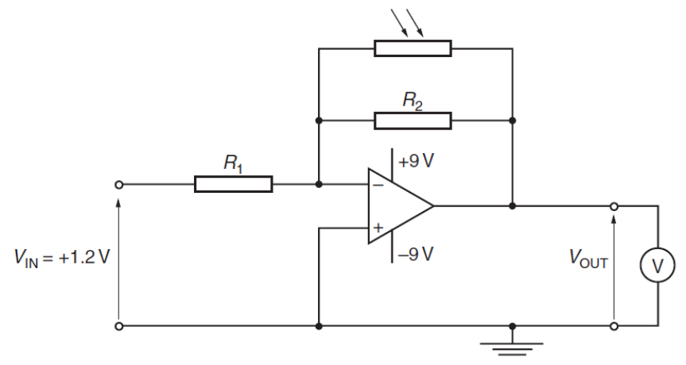
Example 11
The diagram shows the circuit of an op-amp with a light-dependent resistor (LDR) connected as shown.
The resistances R₁ and R₂ are 5.0 kΩ and 50 kΩ respectively.
The input voltage V_{IN} is +1.2 V. A high-resistance voltmeter measures the output V_{OUT}.
The circuit is used to monitor low light intensities.
(a) Determine the voltmeter reading for light intensities such that the LDR has a
resistance of (i) 100 kΩ, (ii) 10 kΩ.
(b) The light incident on the LDR is provided by a single lamp. Use your answers in (a)
to describe and explain qualitatively the variation of the voltmeter reading as the
lamp is moved away from the LDR.

Slide 25
Solution 11
Solution:
(a) The LDR is connected in parallel with R₂
(i) feedback resistance, R_{f} = 33.3 kΩ
gain, A₀ = −R_{f} / R₁ = – 33.3 / 5 = – 6.66
V_{OUT} = A₀ × V_{IN} = – 6.66 × 1.2 = – 8.0 V
(ii) feedback resistance, R_{f} = 8.33 kΩ
V_{OUT} = A₀ × V_{IN} = –(8.33 / 5) × 1.2 = –2.0 V
(b) Moving the lamp away decreases the light intensity
LDR resistance and feedback resistance increase
Gain increases, voltmeter reading increases (Output voltage becomes more negative)

Slide 26
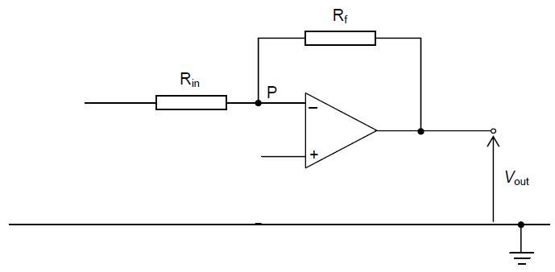
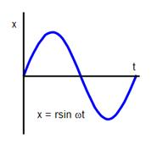
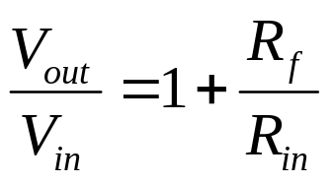
The Non-inverting Amplifier
For non-inverting amplifier, V_{in} is fed into V ⁺.
The non-inverting amplifier is a negative feedback connection.
I
I
V
V
V_{in}
At V ⁺, V = V_{in}
To ensure amplifier is not saturated, V ⁻ ≈ V ⁺ ≈ V_{in}
As V_{P} = V ⁻, therefore V_{P} = V_{in}
Current through R_{in} = Current through R_{f} = I
p.d. across R_{in} and R_{f}: V_{out} – 0 = I (R_{in} + R_{f})
p.d. across R_{in}: V_{p} – 0 = I R_{in} ➔ V_{in} = I R_{in}
Therefore, V_{out} / V_{in} = (R_{in} + R_{f}) / R_{in}
The non-inverting amplifier:
increases the output
produces an output voltage that is in phase with the input voltage.
A₀

Slide 27
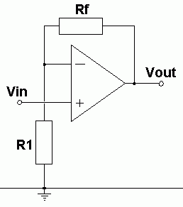
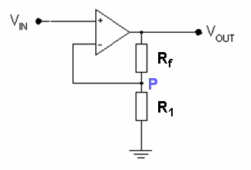
The Non-inverting Amplifier
V_{in} is fed into V ⁺
Equivalent Circuit:
V_{in} is fed into V ⁺
+
The formula for calculating gain, A₀ of a non-inverting amplifier can also be derived using the potential divider rule:
Remember V_{P} = V ⁻ = V_{in}
Therefore,
V_{in} = [R₁ / (R_{f} + R₁)] V_{out}
P
A₀

Slide 28
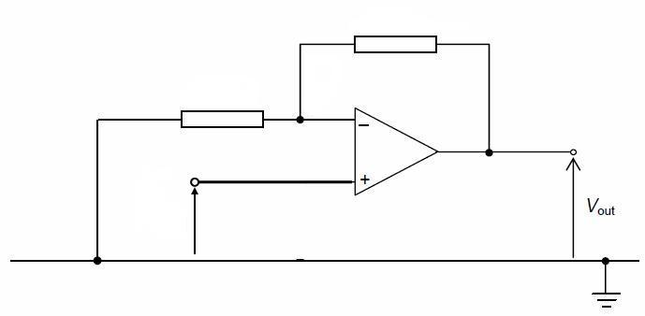
Example 12
10 kΩ
2.0 kΩ
+9V
V_{in}= 0.20 V
−9V
The diagram shows a non-inverting amplifier circuit. Find its voltage gain A₀ and the output voltage.
Solution:
A₀ = 1 + (R_{f} / R_{in}) = 1 + (10 / 2.0) = 6
V_{out} = A₀ × V_{in} = 6 × 0.20 = 1.2 V

Slide 29
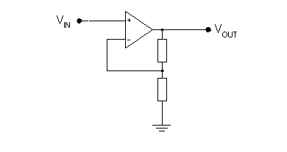
Example 13
+9V
−9V
40 kΩ
10 kΩ
The diagram shows a non-inverting amplifier circuit. Find the V_{out}
when (a) V_{in} = 0.50 V (b) V_{in} = 2.00 V
Solution:
(a) V_{out} = [1 + (R_{f} / R_{in})] × V_{in} = [1 + (40 / 10)] × 0.50 = +2.5 V
(b) V_{out} = [1 + (R_{f} / R_{in})] × V_{in} = [1 + (40 / 10)] × 2.00 = +10.0 V
V_{out} = +9.0 V
saturated

Slide 30
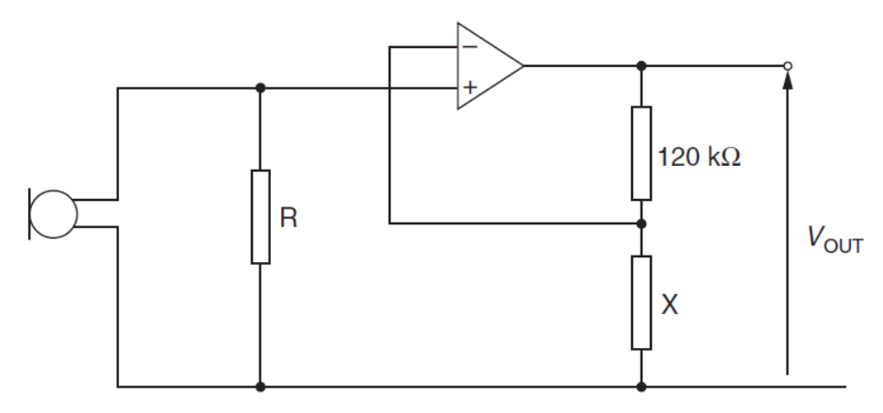
Example 14
An amplifier circuit for a microphone is shown in the diagram.
(a) Name the type of feedback used with this op-amp.
(b) The output potential difference V_{OUT} is 5.8 V for a potential difference across the resistor R of 69 mV. Calculate
(i) the gain of the amplifier circuit,
(ii) the resistance of resistor X.
(c) State one effect on the amplifier output of reducing the resistance of resistor X.
Solution:
(a) Negative feedback (because part of the output is returned to the inverting input).
(b) (i) Gain, A₀ = V_{out} / V_{in} = 5.8 / (69 × 10⁻³) = 84
(ii) A₀ = 1 + (R_{f} / R₁); (R_{f} / R₁) = 84 – 1 = 83; R_{x} = R_{f} / 83 = 120 / 83 = 1.45 kΩ
(c) When R_{x} is reduced, A₀ increases and hence V_{out} increases.

Slide 31
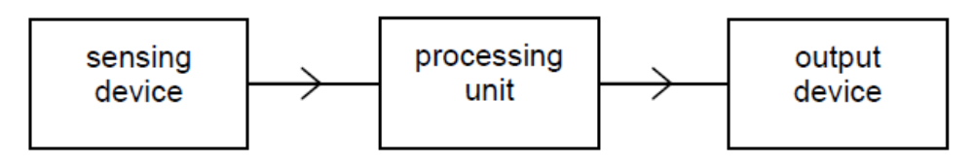
Direct Sensing
The processing unit process the change in the physical property of the sensing device so that it can be indicated by the output device.
Example:
The change in the resistance of the LDR is converted into a change in voltage by a potential divider. The small voltage is amplified.
A sensing device has a physical property changes with a change in whatever it is monitoring.
Example:
An LDR has its resistance change with light intensity.
The output device indicate the change in the monitored property.
Example:
The output device switch on the lamp when it is dark.

Slide 32
Sensing Devices
An LDR has its resistance change with light intensity.
A thermistor has its resistance change with temperature.
A piezo-electric transducer has voltage produced according to sound pressure acting on it.
A strain gauge has its resistance change with the strain acting on it.
(Read the notes given)

Slide 33
Output Devices
The relay
The light-emitting diode (LED)
Digital and analogue meters as output devices.
(Read the notes given)

Slide 34
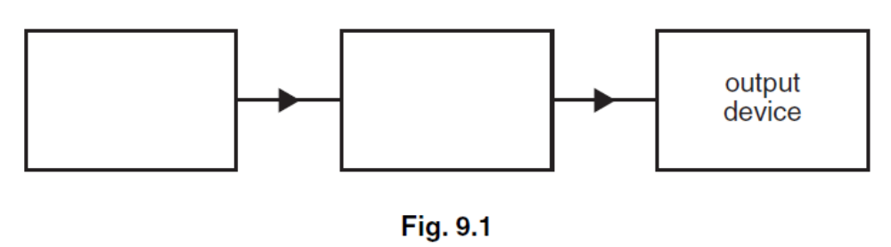
Example
A block diagram for an electronic sensor is shown in Fig. 9.1.
(a) Complete Fig. 9.1 by labelling the remaining boxes.
(b) A device is to be built that will emit a red light when its input is at +2 V. When the input is at –2 V, the light emitted is to be green.
(i) On Fig. 9.2, draw a circuit diagram of the device.
(ii) Explain briefly the action of this device.

Slide 35
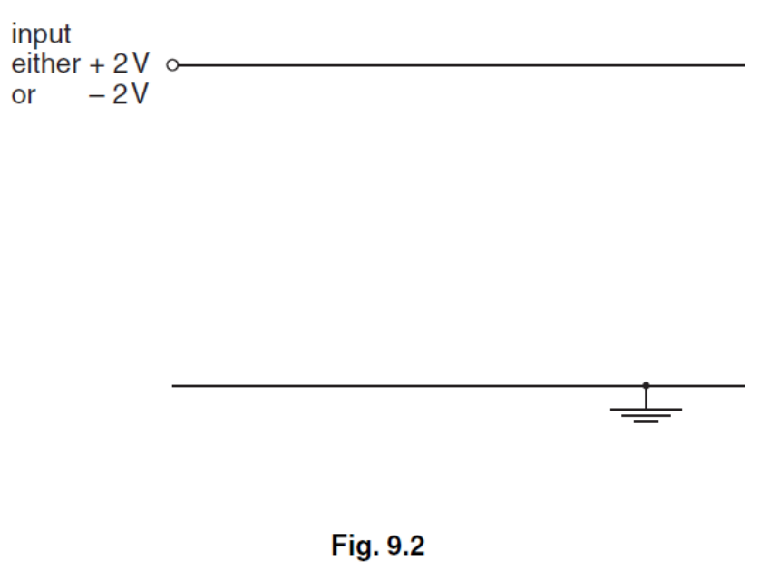
Solution
(a) blocks labelled sensing device / sensor / transducer
processor / processing unit / signal conditioning
(b) (i) two LEDs with opposite polarities (ignore any series resistors)
correctly identified as red and green
(ii) correct polarity for diode to conduct identified hence red LED conducts when input (+)ve or vice versa

Slide 36
The End

